Slide 1
Introduction to
Extended DISC

Slide 2
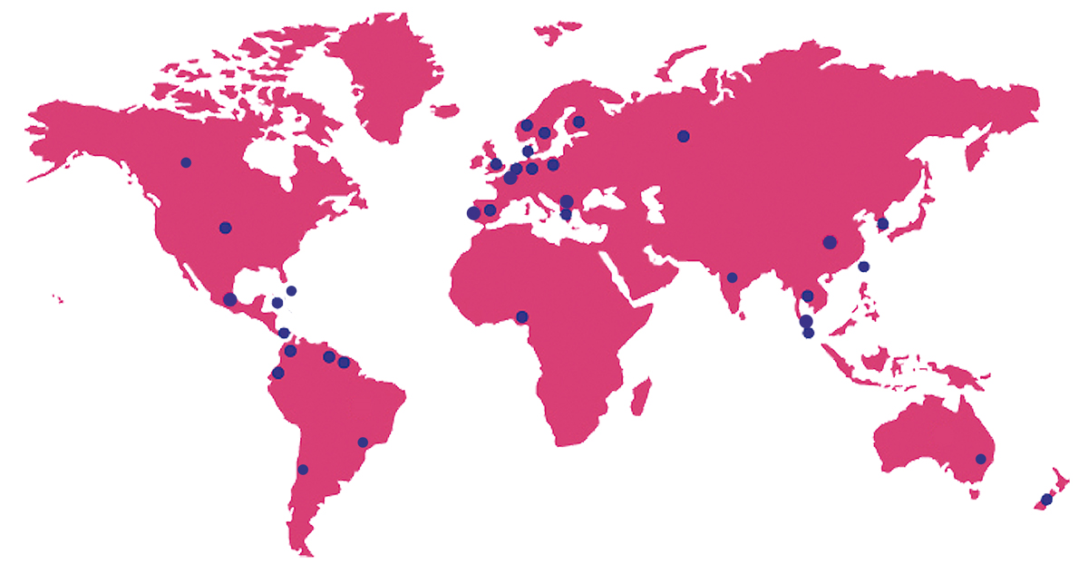

since 2003
In POLAND
Extended DISC
is used in more than 40 countries around the world.

Slide 3
We help
We deliver
In making the right decisions in different areas of human resources management, e.g. selection of employees, career planning, identification of training needs and improving teamwork.
Tools for analysis of behavioural styles, competence assessment, employee engagement surveys, organizational climate.

Slide 4


Talent diagnosis and competence assessment
Engagement and employee satisfaction

Slide 5


Team work
Recruitment decisions

Slide 6
Application of
Extended DISC in the life of organisation

Slide 7


FinxS Platform
Many tools in one place
Behavioral analysis
Surveys Open
360° Feedback
FinxS Sales Assessment

Slide 8
Team Effectiveness
Recruitment processes
Selected applications of Extended DISC tools
Competence development
- training programmes
Individual development planning
Coaching, Mentoring
Talent development programmes
Team potential Audit
Climate Surveys

Slide 9
Recruitment
Simpler HR communication with managers – who are we looking for?, "common language", use of the team map, more complete information about the candidate or new employee
Personal Analysis Extended DISC
Job Profile Extended DISC
Team analysis Extended DISC
Possibility of comparing candidates
Dedicated reports for different types of recipients: recruiter, manager, candidate
Definition of standard profiles for selected positions (job profiles, benchmarking)
Possibility of connecting FinxS platform with e-Recruiter platform / ATS (via API)

Slide 10

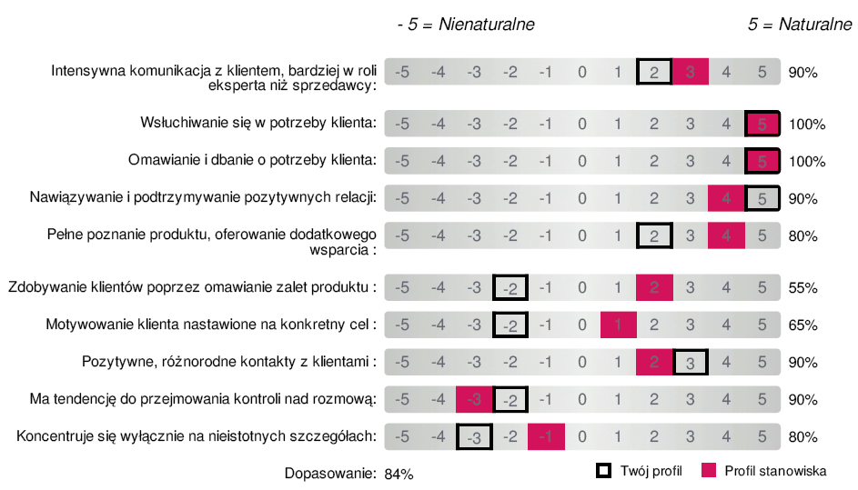
Recruitment
Job profile

Slide 11
Individual development – feedback sesion, coaching, mentoring
Extended DISC Personal Analysis
FinxS 360° Feedback
What natural predispositions and talents does the Client/Manager/employee have?
In which areas does the Client/Manager/employee have the greatest chances of success?
What kind of job/career gives him the greatest satisfaction?
What goals can be ineffective or non-ecological?
What exactly should he pay attention to when working on himself?

Slide 12

Competence development - training programmes (for managers, salespeople, employees)
Extended DISC Personal Analysis
Be conscious of the preferred styles of your co-workers / customers, treat them in an individualised way, consider possible adjustments to your behaviour.
Extended DISC Team Analysis
Get to know the Extended DISC model
Get to know your strengths and areas for development, in relation to your tasks
Learn to recognize the styles of others, employees/customers
Teach to adapt communication and motivations styles to be more effective.

Slide 13
Audit of the team's potential (exemplary scope of the project)
Extended DISC Personal Analysis
Extended DISC Team Analysis
Behavioral analyses for team members
Short presentation and summary reports for participants
Individual and group reports for the Manager
Expert recommendation eg. HR BP for the Manager
Option (in large teams):
Benchmarking Top 10 / Low 10

Slide 14
Extended DISC
Theory

Slide 15
History of Extended DISC
Jung: Die Psychologische Typen
Marston: Emotions of Normal People
DISC System
System Extended DISC
1921
1928
1951
1994
DISC model is based on the work of Carl G. Jung

Slide 16
Human capacity
Conscious behavior
Attitudes
Values
Skills
Knowledge
Experience
Expectations
Physical Condition
Mental Condition
Unconscious behavior
Cultural heritage

Slide 17
The Four Quadrant Model
Thinking
C
D
Logic
Systems
Analyses
Facts
Hard values
Results
Examining
Instructions
Change
Renewal
Sensing
5 senses
Intuition
6. sense
S
I
Tradtions
Checking
Influencing
Generating ideas
Friendliness
Considering others
Emotions
People
Communication
Openness
Feeling

Slide 18
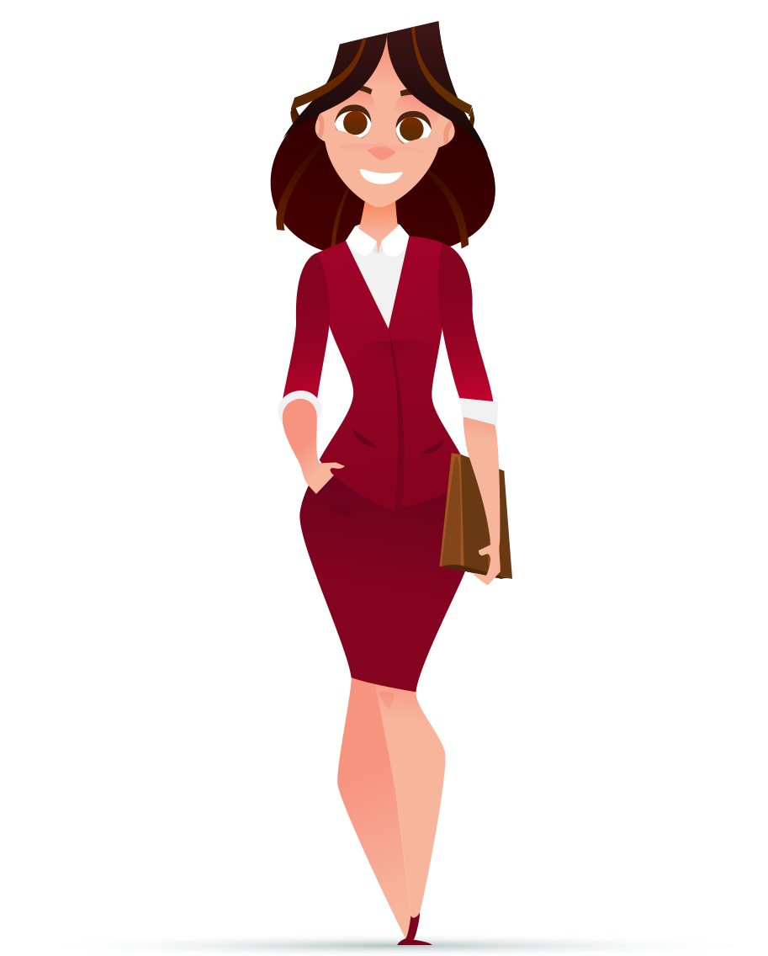
Extended DISC Model – 4 styles behavior
Style
D
Decisive, tough
Strong-willed
Competitive, demanding
Under pressure
Independent, self-centered
lack of concern
Fear
loss of control

Slide 19
Style D – Results-oriented
Describing terms
reorganizer, project leader, idea creator, pioneer
Style
D
How to identify
often interrupts you, speaks on the telephone at the same time, is often in a hurry and has many projects, does not always appear polite
Communication
often one-way from him/her to listeners
presents its opinions as facts which are not subject to discussion
can be unceremonious, says what he thinks
feels comfortable in situations requiring discipline rather than compromise, e.g. in crisis situations

Slide 20
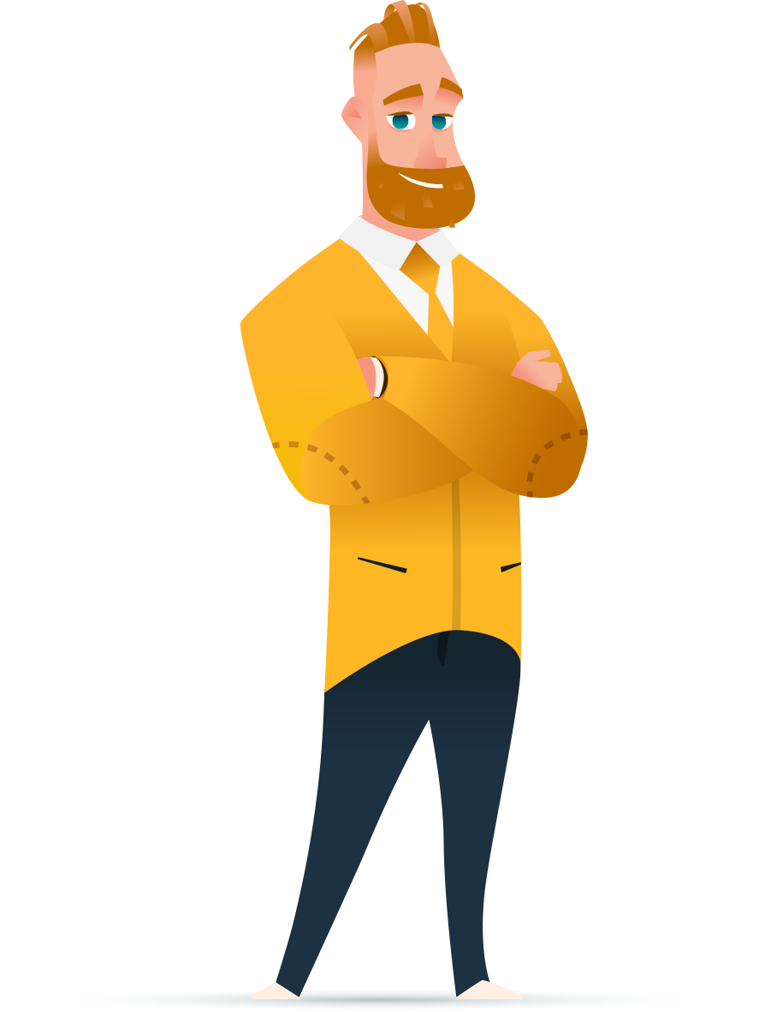
Extended DISC Model – 4 styles of behavior
Style
I
Sociable, talkative, optymistic
Likes to talk, open
Enthusiastic and energetic
Under pressure
Persuasive, inspiring
Disorganized
Fear
Social rejection

Slide 21
Style I – people oriented
Describing terms
performer, merrymaker, idea generator, quick-witted
Style
I
How to identify
excited, open and friendly
expresses when agrees with you
emphasizes the positive side of issues and things
Communications
inspires
loves to talk a lot, but avoids details
avoids raising difficult topics
feels very comfortable giving positive feedback

Slide 22

Extended DISC Model – 4 styles behavior
Style
S
Calm, steady, unhurried
Careful, patient
Good listener, modest
Under pressure
Trustworthy
Too willing
Fear
Loss of stability

Slide 23
Style S - steady
Describing terms
worker with a steady trend, does not get in your face, does not envy others, feet on the ground, balancing force
Style
S
How to identify
secure and stable, proceeds carefully, listens and nods
Communications
S listens
is more likely to speak when it is inquired
speaks in a calm tone
prefers to talk about topics on which he or she is familiar
prefers to talk 1:1
instructs well

Slide 24

Extended DISC Model – 4 styles behavior
Style
C
Precise, pedantic
Follows rules
Logical, careful
Under pressure
Formal, disciplined
overly critical
Fear
criticism of work

Slide 25
Style C - Precise
Describing terms
fears to be wrong, follows the rules, performance criticizer
Style
C
How to identify
things in order,
focuses on details,
polite in a diplomatic way
Communication
prefers written communication
may have difficulty in expressing opposing opinions
fine-tune details
may lose the main thread
does not like to discuss opinions and abstract issues

Slide 26
The Four Quadrant Model
Thinking
C
Precise, follows rules,
logical, careful,
formal, disciplined
D
Decisive, tough, strong-willed,
competitive, demanding,
independent, self-confident
Withdrawn, shy, does not express opinions, gets stuck in details, does not take risks
Aggressive, blunt,
self-centered, Overbearing,
exceeds authority
Sensing
Intuition
S
Calm, steady,careful, patient,
good listener, modest,
trustworthy
I
Sociable, talkative, open,
enthusiastic, energetic,
persuasive
Resists new ideas,
does not express, stubborn,
does not seek change
Flamboyant, frantic,
careless, indiscreet,
excitable, hasty, loses sense of time
Feeling

Slide 27
The Four Quadrant Model – Teamwork
Thinking
D
C
Sensing
Intuition
S
I
Feeling

Slide 28
The stress response
Thinking
C
D
Sensing
Intuition
S
I
Feeling

Slide 29
Individual reports
Extended DISC

Slide 30
Individual Analysis Extended DISC
What does it measure?
What is it?
Simple model to identify basic styles of behavior that helps to improve interactions between people Inventory of natural reactions of the respondent
It measures natural (spontaneous) reactions of respondent to the external stimulators.

Slide 31
Extended DISC Personal Analysis
What it doesn’t measure?
What isn’t doing?
Extended DISC® Behavioral Analysis is a self-assessment tool for measuring the person's natural behavioral style – not for professional full personality analysis
It does not classify people into good or bad categories or more or less intelligent. It does not measure intelligence, professional skills. It does not in any other way classify people into better or worse.

Slide 32
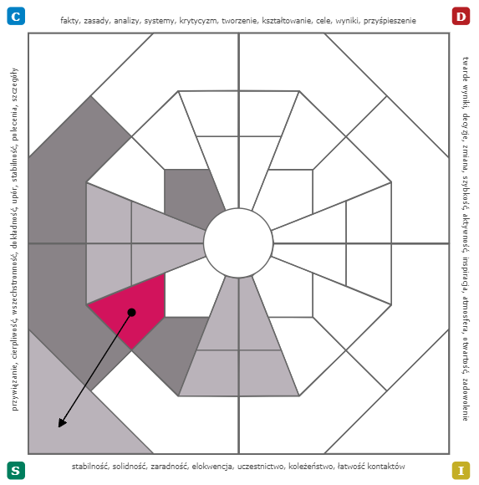
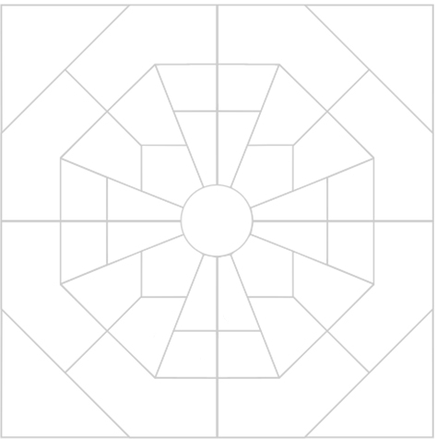
Extended DISC Diamond
Flexibility zones
Energy intensive
areas
Areas with low energy requirements

Slide 33
Extended DISC Diamond
Flexibility zones – areas of comfortable behaviour – painted sectors
The most intense style – dot
Adaptation needed – arrow
Areas requiring the most energy – white sectors

Slide 34
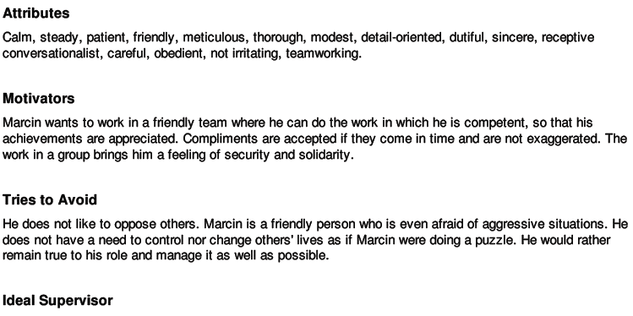
Individual Reports Extended DISC
Text Page
Description of typical behaviours of people with a similar style
–Ask others for feedback and comments!

Slide 35
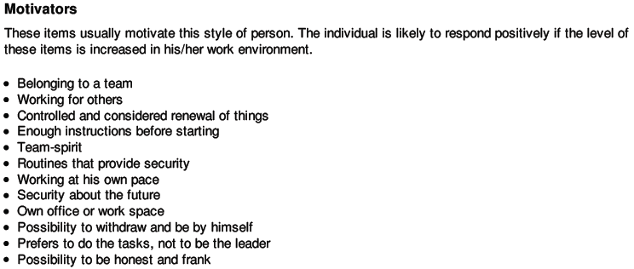
Individual Reports Extended DISC
Motivators

Slide 36
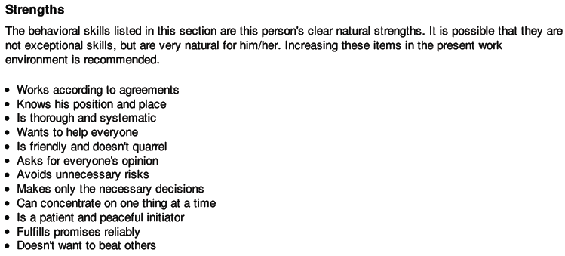
Individual Reports Extended DISC
Strengths

Slide 37
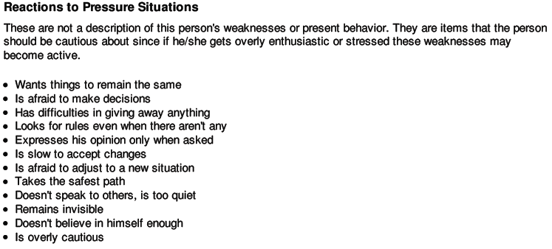
Individual Reports Extended DISC
Reactions to Pressure Situations
This is a description of the potential risks,
And not the current style of behavior!

Slide 38
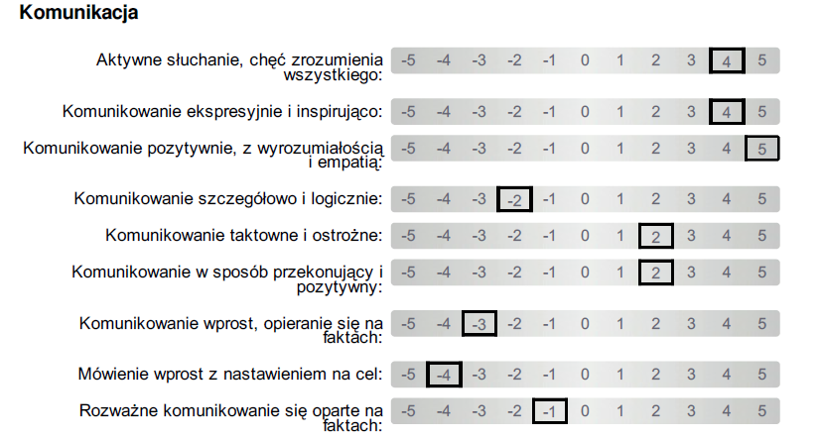
Individual Reports Extended DISC
Behavioral Criteria
It is not a scale of „what can and cannot”.

Slide 39
Extended DISC
Team Analysis

Slide 40
Extended DISC Team analysis
What is it?
A tool for:
Team Analysis is based solely on Individual Analysis results of team members
Describes the natural style of behavior of the team
Identifies the strengths of each team member
Team development
Improving communication within the team
increasing effectiveness
troubleshooting

Slide 41
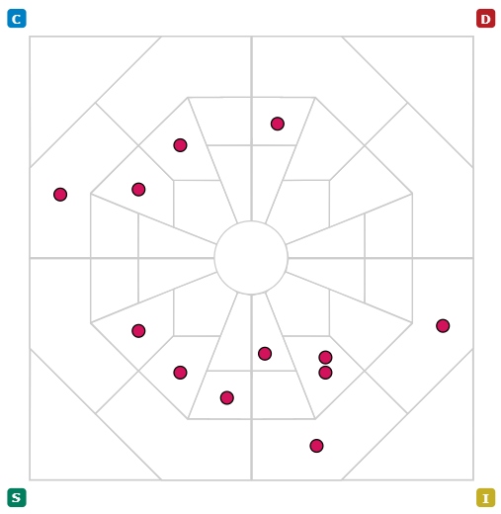
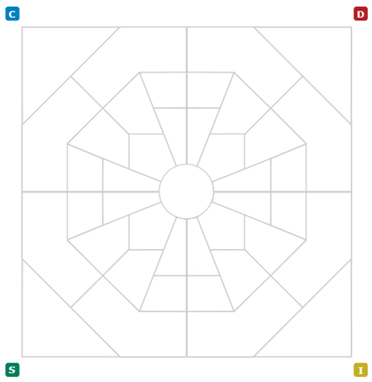
Team Analysis
shotgunmap

Slide 42
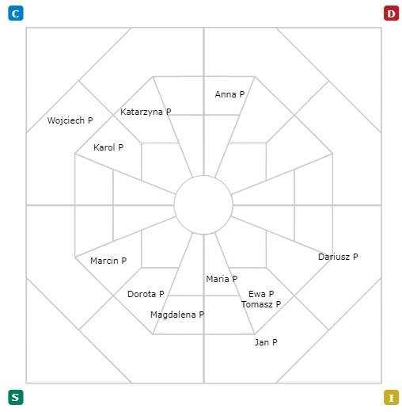
Team Analysis
Name map

Slide 43
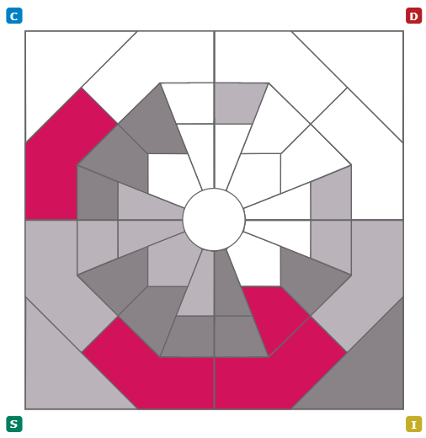
Team Analysis
Flexibility zone

Slide 44
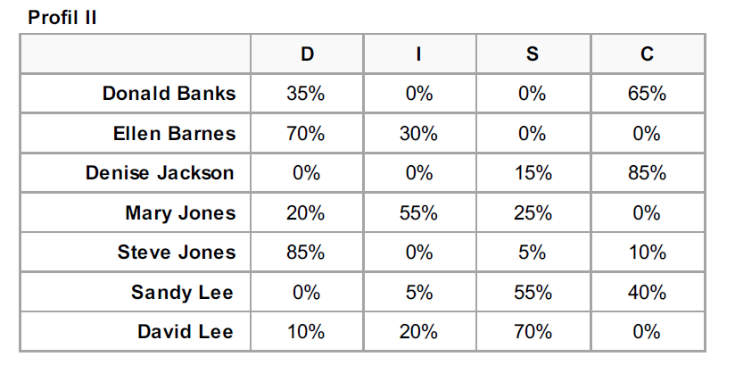
Team Analysis
Percentage table

Slide 45
Extended DISC Team analysis
Where can it be used?
Organisational development
Team building
At organisational level
At team
level
Improving communication in the organization
Change in organisation
Communication in a team
Problem solving

Slide 46
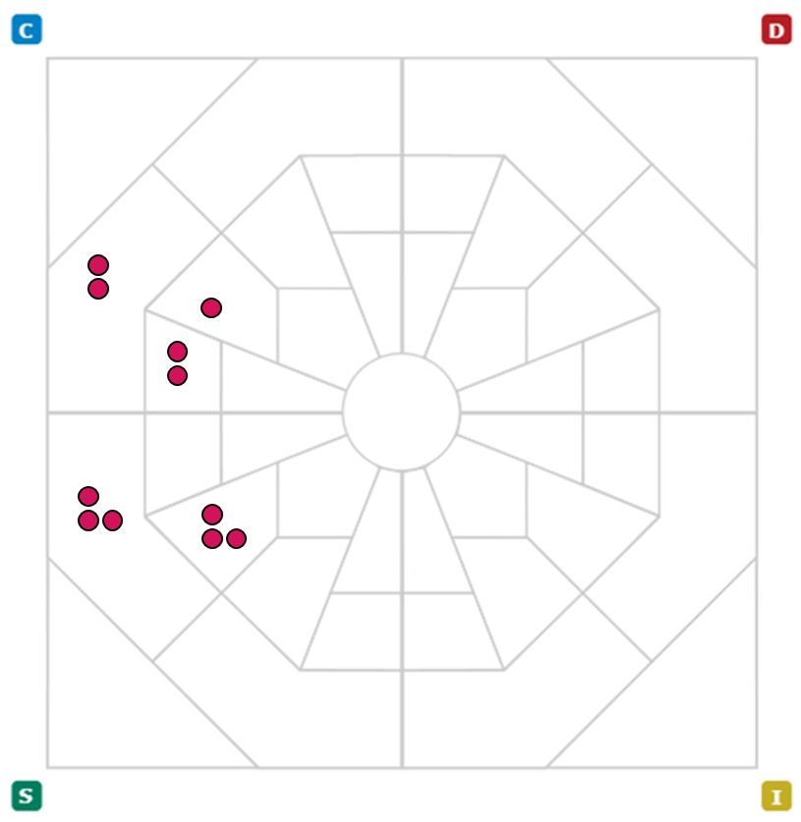
Types of teams
Homogenous Team
Strength
communication
Challenge
flexibility

Slide 47
Types of teams
Heterogeneous Team
Strength
Division of labor
Challenge
Communication

Slide 48
Types of teams
Diverted Team
Strength
Delegation
Challenge
Sub-teaming

Slide 49
Types of teams
Team Analysis
D
= 10%
I
= 15%
S
= 40%
C
= 35%

Slide 50
Team report – shotgun map
Where are our strengths?
Where are our weaknesses?
Do we have a concentration of any behavior?
How does this affect the team?
What behaviors are missing?
How can we substitute them?
Shotgun Map
Flexibility Zone

Slide 51
Extended DISC
Leader’s profile

Slide 52
What does it mean to be a leader?
Challenging the status quo
Care for quality
Challenges
Systematic planning
Persuasion
Support
Motivating the team
Building relationships

Slide 53
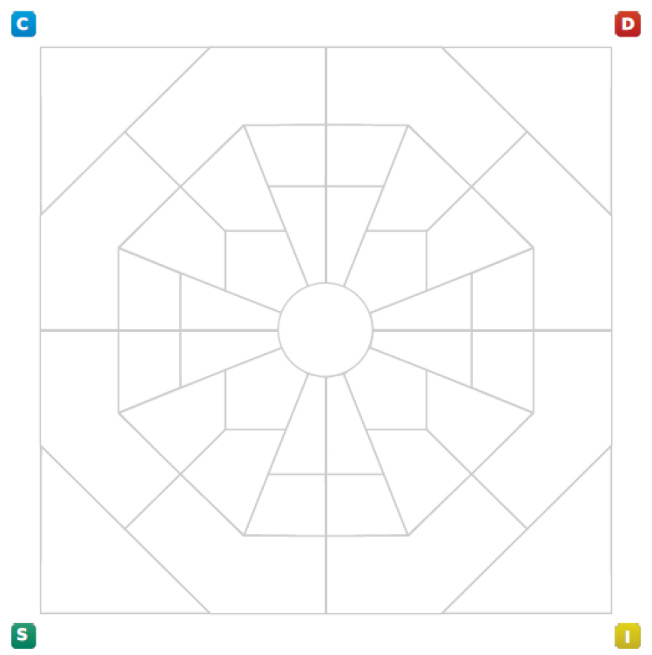
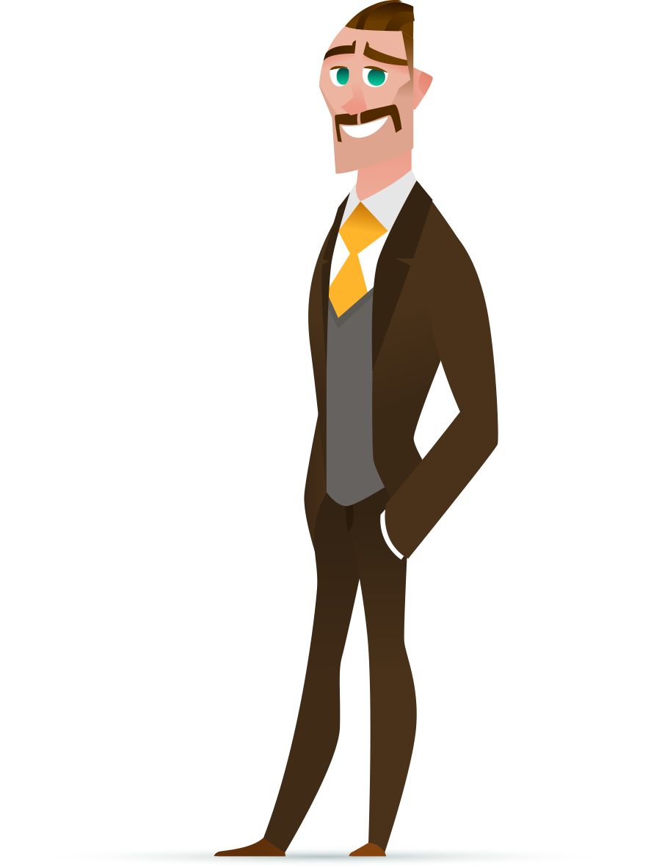
What kind of leader will Adam be?
Let's get to know
Adam a little better

Slide 54
Adam and his challenges…
Challenging the status quo
Care for quality
Challenges
Systematic planning
Persuasion
Support
Motivating the team
Building relationships

Slide 55

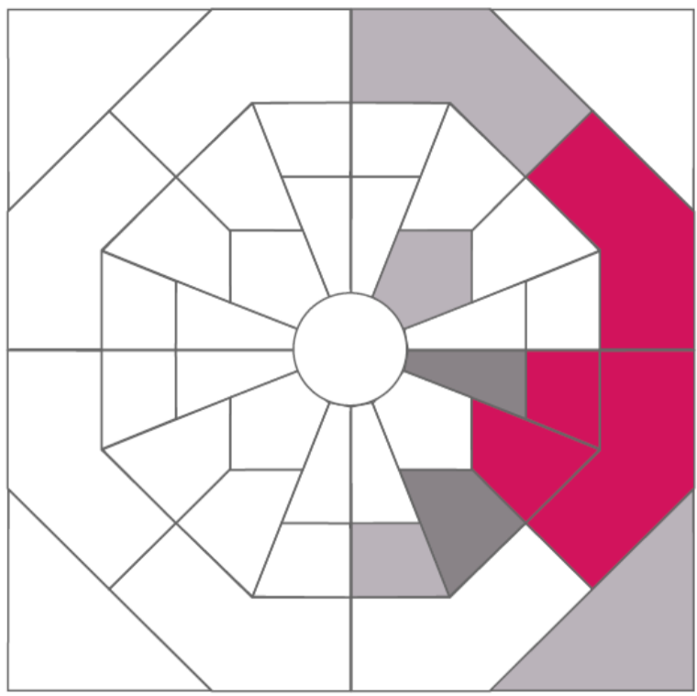
What about Eva?

Slide 56
Eva and her challenges…
Challenging the status quo
Care for quality
Challenges
Systematic planning
Persuasion
Support
Motivating the team
Building relationships

Slide 57
Changes in the
Polish population
according Extended DISC
research

Slide 58
Extended DISC model – The Four Quadrant Model
Thinking
C
D
Sensing
5 senses
Intuition
6 sense
S
I
Feeling

Slide 59
The Four Quadrant Model
Thinking
Precise
Follows rules
Logical, careful
Formal, disciplined
Decisive, tough
Strong-willed
Competitive, demanding
Independent, self-centered
C
D
Sensing
5 senses
Intuition
6. sense
Calm, steady
Careful, patient
Family-oriented, modest
Good listener, trustworthy
Sociable
Talkative, open
Enthusiastic, energetic
Persuasive
S
I
Feeling

Slide 60
The Four Quadrant Model
Thinking
Withdrawn, shy
Does not express opinions
Gets stuck in details
Does not take risks
Aggressive, blunt
Self-centered
Overbearing
Exceeds authority
C
D
Sensing
5 senses
Intuition
6. sense
Resists new ideas
Does not express
Stubborn
Does not seek change
Flamboyant, frantic
Careless, indiscreet
Excitable, hasty
Loses sense of time
S
I
Feeling

Slide 61
Distribution of behavior styles according to the Extended DISC model in the Polish population (2024)
D – 11,8%
I – 19,4%
S – 45,4%
C – 23,4%

Slide 62
What does it mean for employers?
What motivates people with a given style?
Super atmosphere and space for new ideas - As little bureaucracy as possible
Respect, trust, good planning, teamwork, balance between work and family life
We want to take on difficult challenges and decide for ourselves. We value individual goals and awards
Clear rules and procedures, high quality, concrete data. Possibility of specialisation

Slide 63
What does it mean for employers?
Respect, trust, good planning, teamwork, balance between work and family life
What motivates people with a given style?
Super atmosphere and space for new ideas - As little bureaucracy as possible
Clear rules and procedures, high quality, concrete data. Possibility of specialisation
We want to take on difficult challenges and decide for ourselves. We value individual goals and awards

Slide 64
Distribution of behavior styles according to the Extended DISC model in Polish and and Worldwide – 2024 (%)
World
Poland
8,7% – D
D – 11,8%
26,1% – I
I – 19,4%
34% – S
S – 45,4%
31,2% – C
C – 23,4%

Slide 65
What does it mean for employers?
What differentiates us from the populations of other countries?
We are not very open,
We do not like praising and selling,
Popularity = hate
Rather conservative
We like risk, we play sharply, we are enterprising, we like to argue
Moderate analytical facility

Slide 66
And how do generations differ? (as of 2020)
D
I
S
C
16%
18%
21%
14%
12%
16%
19%
26%
45%
42%
38%
38%
27%
24%
22%
22%
Born in <1960
Born in years 60
Born in years 70
Born in years 80

Slide 67
And how do generations differ? (as of 2020)
21%
14%
19%
32%
38%
35%
D
I
S
C
22%
19%
Born in years 70
Born in years 90

Slide 68
In the generation born in the 90s there is 1/3 less D than in the 70s.
Are we less interested in the rat race?
Don't want to sacrifice your personal life for your career?
……?
21% >> 14%

Slide 69
In the generation born in the 90's there is more than 1/3 more I than in the 70's
Are we more and more open to people, communicative?
Are we more and more interested in good relations and atmosphere at work, 2 times more than in results? (D vs I)
……?
19% >> 32%

Slide 70
Conclusions for Leaders
When creating Employer Branding campaigns
Consider which generation group you are targeting.
Consciously manage diversity behavioural, generational, sexual
and cultural, and you will avoid unnecessary conflicts and bring out the potential.
Don't believe in stereotypes
use diagnostic tools
If you want to attract and retain representatives of generation Y Build an adequate leadership culture in your organisation
Remember the platinum rule
treat others as they would like to be treated

Slide 71
Thank you for your attention
Extended DISC

Slide 72

Do you have any questions?
Contact us!
info@extendeddisc.com.pl
facebook.com/ExtendedDISCPolska
22.866.54.75
www.extended.tools

